Slide 1
Keynote: Desktop Presentation tool testing types
Taras Travinskyy
01/22/2016

Slide 2
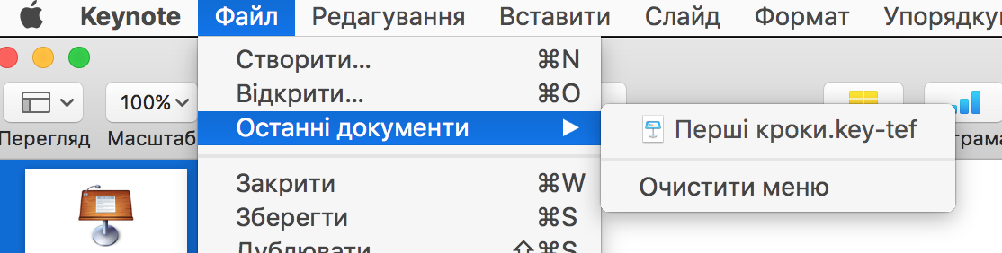
Functional testing
Requirement: User is able quickly reopen last opened documents.
Functional Testing Procedure:
check if menu item present;
open and close different documents- check if the appear in the list and in correct order;
check if document is reopened- it should be excluded from list;
verify list maximum capacity of 10 documents;
check ‘Clear list’ function
Defect: list should consist of 10 last opened documents, but user is able to see and reopen only one last opened document.

Slide 3
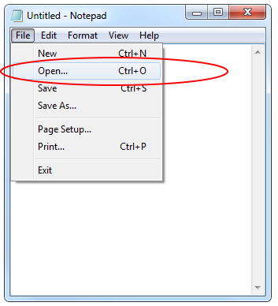
Smoke testing Example
Task: Test new version of a Notepad application.
Smoke Testing Procedure: quickly check the main Notepad features (run application, type text, open file, edit file, save file).
Defect: There is no ability to Open a file. Button “Open” does nothing.
Summary: build is not accepted, critical bug is logged to a Bug Tracking system, developers team and project manager are informed by QC engineer about that fact.

Slide 4



Performance testing Example
Task: Server should respond in less than 2 sec when up to 100 users access it concurrently. Server should respond in less than 5 sec when up to 300 users access it concurrently.
Performance Testing Procedure: emulate different amount of requests to server in range (0; 300), for instance, measure time for 10, 50, 100, 240 and 290 concurrent users.
Defect: starting from 200
Concurrent requests
respond time is 10-15 seconds.

Slide 5

Load testing Example
Task: Server should allow up to 500 concurrent connections.
Load Testing Procedure: emulate different amount of requests to server close to pick value, for instance, measure time for 400, 450, 500 concurrent users.
Defect: Server returns “Request
Time Out” starting from 490
concurrent requests.

Slide 6
Stress testing Example
Task: Server should allow up to 500 concurrent connections.
Stress Testing Procedure: emulate amount of requests to server greater than pick value, for instance, check system behavior for 500, 510, and 550 concurrent users.
Defect: Server crashes starting
from 500 concurrent requests
and user’s data is lost.
Data should not be lost even in
stress situations. If possible,
system crash also should be avoided.

Slide 7

Localization testing Example
Task: Verify that ‘Login’ page is translated to German
Localization Testing Procedure:
Test all labels and captions on the page whether they are translated to German; force appearance of different messages (e.g.: when password or login does not exist) to check whether they are localized and not truncated
Defects:
“Password you have entered does not exist in the system” message is truncated on German Locale;
“Login” label is not translated and still appears in English under German locale.
Notes:
Localization is the process of adapting a globalized application to a particular culture/locale. Localization includes the translation of the application user interface and adapting graphics for a specific culture/locale. The localization process can also include translating any help content associated with the application.
Localization (L10N) testing checks how well the application under test has been Localized into a particular target language.
Because every country’s language, culture, currency, taxes and standards are different, it’s imperative for companies to test how well their applications perform with different aspects of international culture.

Slide 8

Internationalization testing Example
Task:
Verify that list of users with German special characters (e.g.: “ü”, “ß” etc) in names are sorted correctly by ‘First Name’ column
Functional Testing Procedure:
Create enough different users with special characters in First Name. Sort them via the table to ensure that special characters are sorted correctly
Defect:
Sorting performs incorrectly: all names which start from special characters (e.g.: “ü”, “ß” etc) are always listed at the end of the sorted column. Instead they should be sorted with all other characters (e.g.: “ß” at once after word with “ss”, but on at the end of the list)
Notes:
Internationalization is the process of designing and coding a product so it can perform properly when it is modified for use in different languages and locales.
Internationalization (I18N) testing checks if all data/time/number/currency formats are displayed according to selected locale and if all language specific characters are displayed.

Slide 9
Task is:
1. select testing types to be applied while testing corresponding application;
2. write down the requirements to be verified (one requirement per testing type);
3. describe how the testing is going to be performed (for every selected testing type):
4. present results in .ppt format

Slide 11
Thank you
US OFFICES
Austin, TX
Fort Myers, FL
Boston, MA
Newport Beach, CA
Salt Lake City, UT
EUROPE OFFICES
United Kingdom
Germany
The Netherlands
Ukraine
Bulgaria
EMAIL
info@softserveinc.com
WEBSITE:
www.softserveinc.com
USA TELEPHONE
Toll-Free: 866.687.3588
Office: 239.690.3111
UK TELEPHONE
Tel: 0207.544.8414
GERMAN TELEPHONE
Tel: 0692.602.5857

